Slide 1

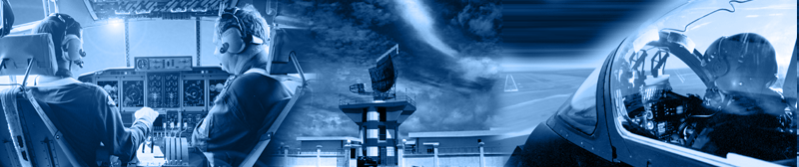

A320 FFS
Maintenance Technician
Training Course
Prepared By: Mohamed Sakr
Computer Room
Network Connection
Thales Training & Simulation

Slide 2

OBJECTIVES
1- Overview of Network connection for Computers & Interfaces
2- Identify the components of the computer Network installation
including :-
Host computer
CDF compute
IOS Computer
Peripherals & interface devices
3- Understand the operation as a general overview
4- Knowledge for Backup and Restore of all Computer systems within the Simulator architecture using Disk Imaging or Norton ghost software
Notes:
Feb 02
R J Mckay Instructor Notes TTSL Prod Training Department
Computers 2-1 <number>

Slide 3
Hub
Onboard
display
A320 FFS
Laptop
HOST
screen
Host
Industrial PC
CDF
Tower
PC
IOS
Tower
PC
Visual
CDF
screen
AKAI
Sampler
Off board
IO
Repadis
MOS
Repadis
COS
Repadis
ARINC
VME
IOS
screen
S
S
I
P
S
S
I
P
COMMS1
On board
IO
Repadis
IOS
screen
COS 16
COMMS2
Field Bus
Under Floor
IO
Repadis
Ethernet to Visual
MODU
COMMS3
RS232/422/MIDI
Ethernet Simulator Network
HSSL RMB
RjY
HSSL Repeater
VGA

Slide 4
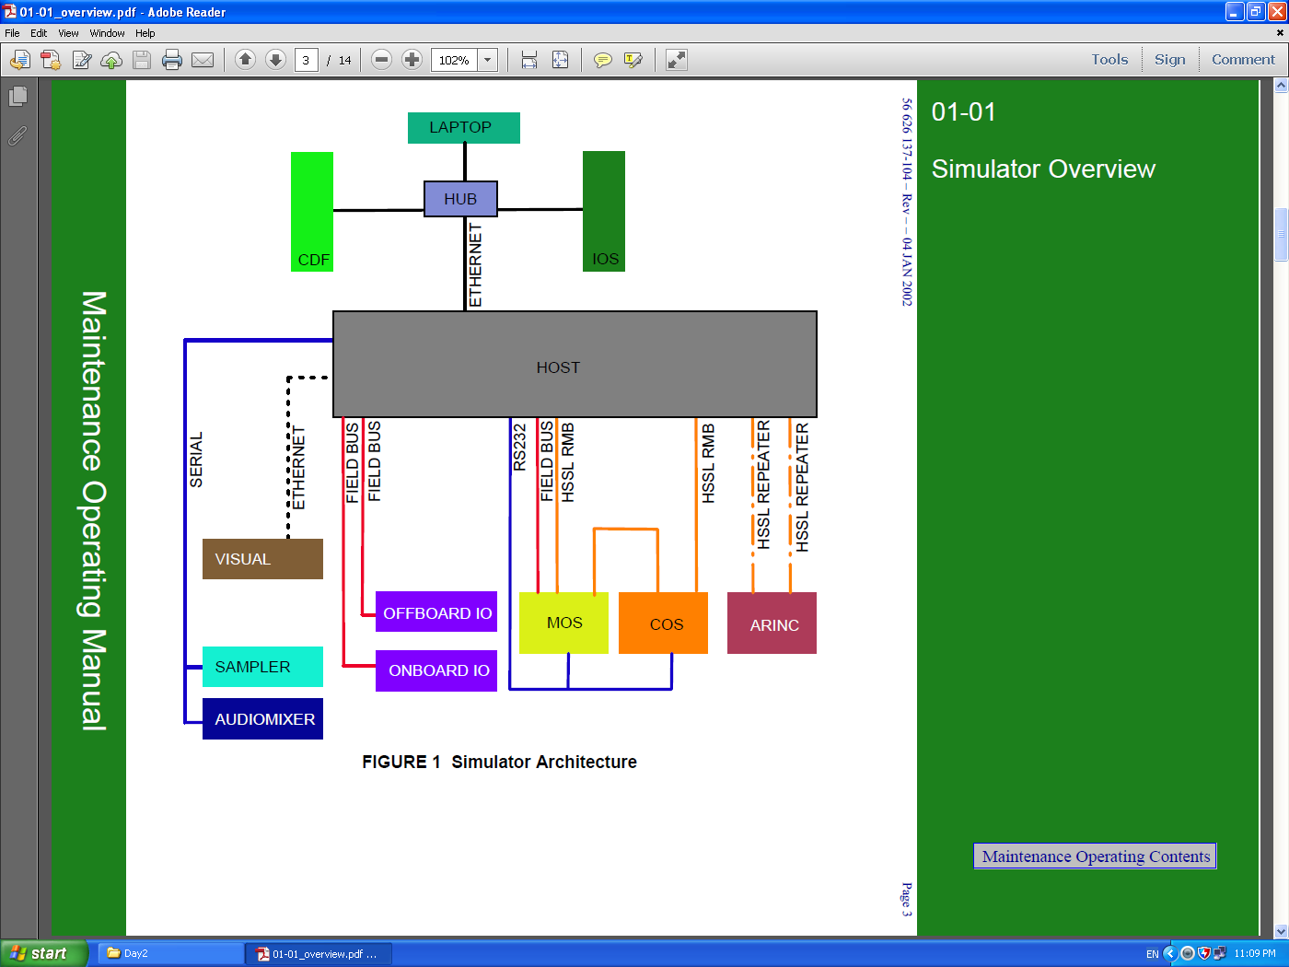

Slide 5
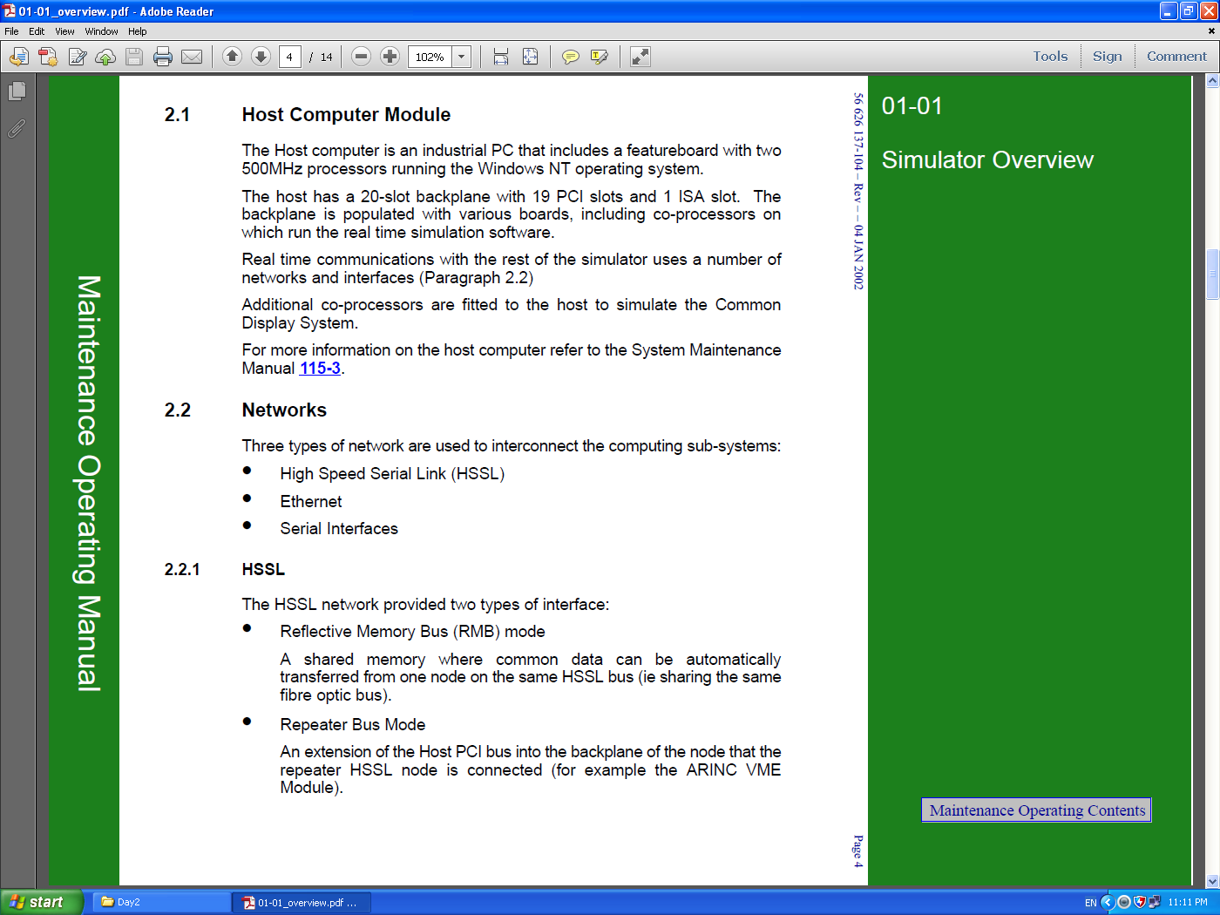

Slide 6
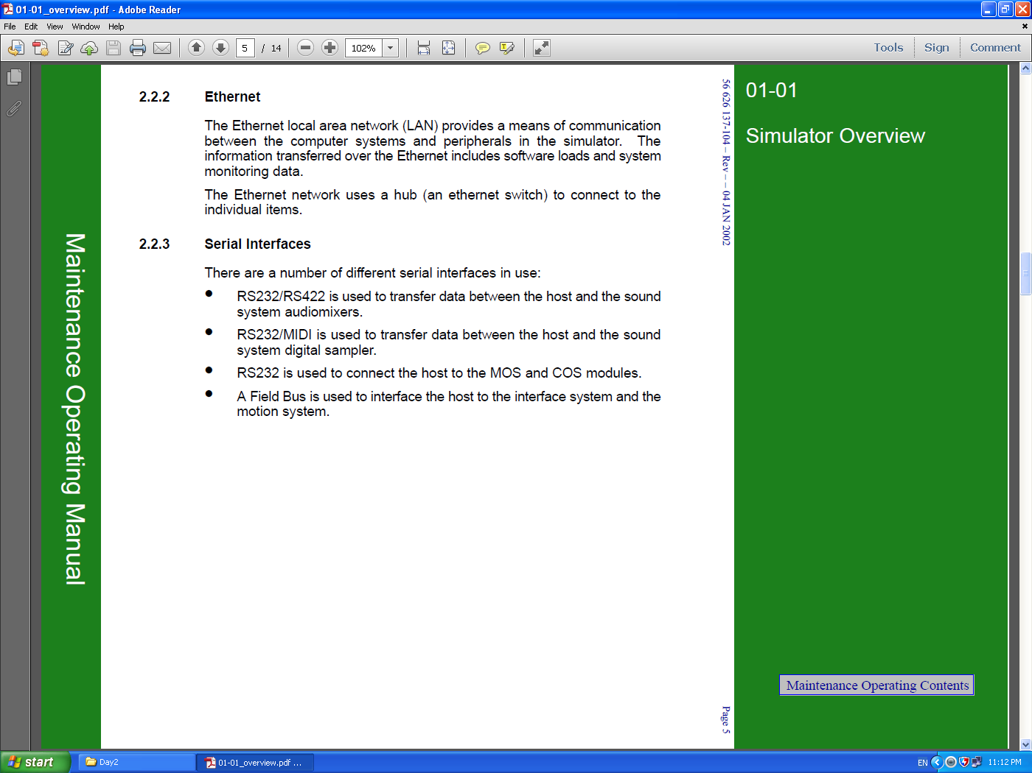

Slide 7
A320 FFS
HOST
PC
C
D
Off board
IO
Repadis
MOS
Repadis
On board
IO
Repadis
HPU
PLC
Under Floor
IO
Repadis
FFS Field Bus Network Architecture
Notes:
Feb 02
R J Mckay Instructor Notes TTSL Prod Training Department
Computers 2-1 <number>

Slide 8
FFS Visual Ethernet Network Architecture
EGT A330/340 FFS
Host
PC
Visual
Notes:
Feb 02
R J Mckay Instructor Notes TTSL Prod Training Department
Computers 2-1 <number>

Slide 9
IOS
PC
A320 FFS
HOST
PC
C
C
D
D
USB
USB
R
S
2
3
2
IOS
screen
MOS
Repadis
COS
Repadis
ARINC
429
RS232
IOS
screen
MODU
R
S
2
3
2
USB Terminal
Server
RS232
USB Terminal
Server
FFS IOS Architecture
Notes:
Feb 02
R J Mckay Instructor Notes TTSL Prod Training Department
Computers 2-1 <number>

Slide 10
A320 FFS
HOST
PC
C
D
MOS
Repadis
COS
Repadis
ARINC
429
FFS HSSL Network Architecture
Notes:
Feb 02
R J Mckay Instructor Notes TTSL Prod Training Department
Computers 2-1 <number>

Slide 11
A320 FFS
CDF
PC
Ethernet Switch
Laptop
C
C
D
IOS
PC
D
CDF
screen
HOST
PC
C
C
D
D
FFS Ethernet Network Architecture
Notes:
Feb 02
R J Mckay Instructor Notes TTSL Prod Training Department
Computers 2-1 <number>

Slide 12
FFS Ethernet Network Architecture
Laptop
Client NT Workstations
Disk
CDF
PC
IOS
PC
Server NT windows
Hub
Disk
Disk
Host
PC
Disk
Notes:
Feb 02
R J Mckay Instructor Notes TTSL Prod Training Department
Computers 2-1 <number>

Slide 13
A320 FFS Domain Architecture
A320 CDF
Server NT windows
IOS
HOST
NT member client
NT member client
Laptop
NT
member client
Notes:
Feb 02
R J Mckay Instructor Notes TTSL Prod Training Department
Computers 2-1 <number>

Slide 14
A320 FFS Domain Architecture
Simulator Domain
A320 CDF
SERVER
C
D
HOST
Laptop
IOS
Laser
Printer
Notes:
Feb 02
R J Mckay Instructor Notes TTSL Prod Training Department
Computers 2-1 <number>

Slide 15


References : THALES STD simulator Manufacture manual .
?
Please Feel free to Ask
Practical

